Slide 1
Software engineering (Undergraduate)
Chapter 12 software testing
Course Name software engineering
CSC 3114
(Undergraduate)
Mejbah Ahammad,
Lecturer, DS, AIUB
+8801308757586
Email: ahammadmejbah@aiub.edu
Room Number: DN0922

Slide 2
Software testing
Slide-2
Testing is the process of exercising a program with the specific intent of finding errors prior to delivery to the end user
Software testability is simply how easily [a computer program] can be tested
Testing Shows
Error
Requirements Conformance
Performance
An indication of quality
SB

Slide 3
Who tests the software?
Slide-3
Developer
Understands the system but, will test "gently“ and, is driven by "delivery“
Experiencing the software operation (known to the developer)
Independent tester
Must learn about the system, but, will attempt to break it and, is driven by “quality”
Exploring the software operation (unknown to the tester)
SB

Slide 4
V & V
Slide-4
Validation refers to a different set of tasks that ensure that the software that has been built is traceable to customer requirements.
Verification refers to the set of tasks that ensure that software correctly implements a specific function/process.
Boehm states this another way:
Validation: "Are we building the right product?“
Verification: "Are we building the product right?"
SB

Slide 5
Testing Strategy
Slide-5
We begin by ‘testing-in-the-small’ and move toward ‘testing-in-the-large’
For conventional software
The module (component) is our initial focus
Integration of modules follows
For OO software
Our focus when “testing in the small” changes from an individual module (the conventional view) to an OO class that encompasses attributes and operations and implies communication and collaboration
SB

Slide 6
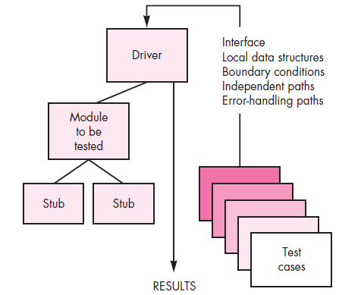
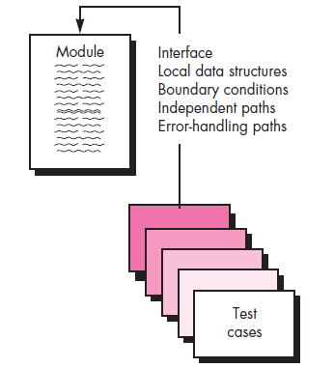
Unit testing
Slide-6
Tests a small software unit at a time, which is typically performed by the individual programmer who implemented the unit prior to Integration testing
Stub: it is the behavior of the lower-level modules that are under development and not yet integrated to other modules
SB

Slide 7
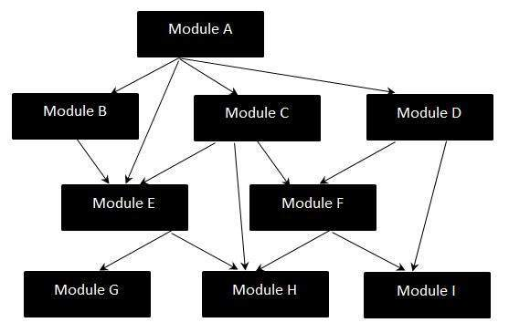
Integration testing strategies
Slide-7
System integration testing (SIT) is a systematic technique for assembling a software system while conducting tests to uncover errors associated with interfacing the modules
the “big bang” approach: Big Bang Integration Testing is an integration testing strategy where all units are linked at once, resulting in a complete system.
SB

Slide 8
smoke testing
Slide-8
Smoke testing steps:
Software components that have been translated into code are integrated into a “daily build”
Smoke testing, also known as "Build Verification Testing" is a type of software testing that is typically performed at the beginning of the development process to ensure that the most critical functions of a software application are working correctly.
It is used to quickly identify and fix any major issues with the software before more detailed testing is performed.
The goal of smoke testing is to determine whether the build is stable enough to proceed with further types of testing.
SB

Slide 9
Object-oriented testing
Slide-9
Class testing is the equivalent of unit testing
Operations within the class are tested
The state behavior of the class is examined
Integration applied three different strategies
Thread-based testing—integrates the set of classes required to respond one input or event
Use Case based testing—integrates the set of classes required to respond to one use case
Cluster testing—integrates the set of classes required to demonstrate one collaboration
SB

Slide 10
Higher order testing
Slide-10
System testing: focus is on system integration (e.g. hardware integration, OS compatibility)
Alpha testing is an internal, controlled process to find bugs and technical issues within a nearly complete product, performed by developers and QA engineers in a lab setting.
Beta testing is an external, real-world process that involves end-users from the target market to gather feedback on functionality, usability and overall user experience before the final release.
Recovery testing: forces the software to fail in a variety of ways and verifies that recovery is properly performed
Security testing: verifies that protection mechanisms built into a system will, in fact, protect it from improper penetration
Stress testing: executes a system in a manner that demands resources in abnormal quantity, frequency, or volume
Performance Testing: test the run-time performance of software within the context of an integrated system (e.g. time required to response a request, compliance with operational constraints)
SB

Slide 11
Debugging
Slide-11
In many cases, the non-corresponding data are a symptom of an underlying cause as yet hidden error
The debugging process attempts to match symptom with cause, thereby leading to error correction
symptom may disappear when another problem is fixed
cause may be due to a combination of non-errors
cause may be due to a system or compiler error
cause may be due to assumptions that everyone believes
SB

Slide 12
Debugging techniques
Slide-12
Brute force testing
most common; but least efficient
memory dumps are taken, run-time traces are invoked, and the program is loaded with output statements (Dynamic Testing)
Backtracking
common debugging approach that can be used successfully in small programs
source code is traced backward (manually) until the cause is found
Cause elimination
a “cause hypothesis” is devised
if initial tests indicate that a particular cause hypothesis shows promise, data are refined in an attempt to isolate the bug (c/a-b where the possibility of a-b is zero)
SB

Slide 13
White-box testing
Slide-13
Using white-box testing methods, you can derive test cases that
guarantee that all independent paths within a module have been exercised at least once,
exercise all logical decisions on their true and false sides,
execute all loops at their boundaries and within their operational bounds, and
exercise internal data structures to ensure their validity.
SB

Slide 14
Black-box testing
Slide-14
Focuses on the functional requirements of the software
Black-box testing attempts to find errors in the following categories:
incorrect or missing functions
interface errors
errors in external database access (accessibility)
behavior or performance errors
initialization and termination errors
SB

Slide 15
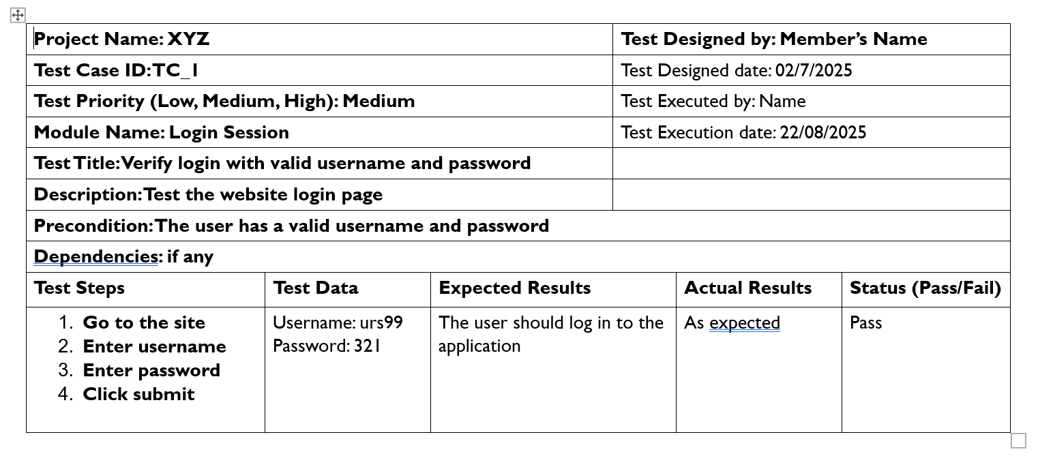
Test Case sample

Slide 16
references
Slide - 23
R.S. Pressman & Associates, Inc. (2010). Software Engineering: A Practitioner’s Approach.
Kelly, J. C., Sherif, J. S., & Hops, J. (1992). An analysis of defect densities found during software inspections. Journal of Systems and Software, 17(2), 111-117.
Bhandari, I., Halliday, M. J., Chaar, J., Chillarege, R., Jones, K., Atkinson, J. S., & Yonezawa, M. (1994). In-process improvement through defect data interpretation. IBM Systems Journal, 33(1), 182-214.
SB

